Slide 1



California Power Generation & Power sources
Who Run THE WORLD energy PROJECT

Slide 2
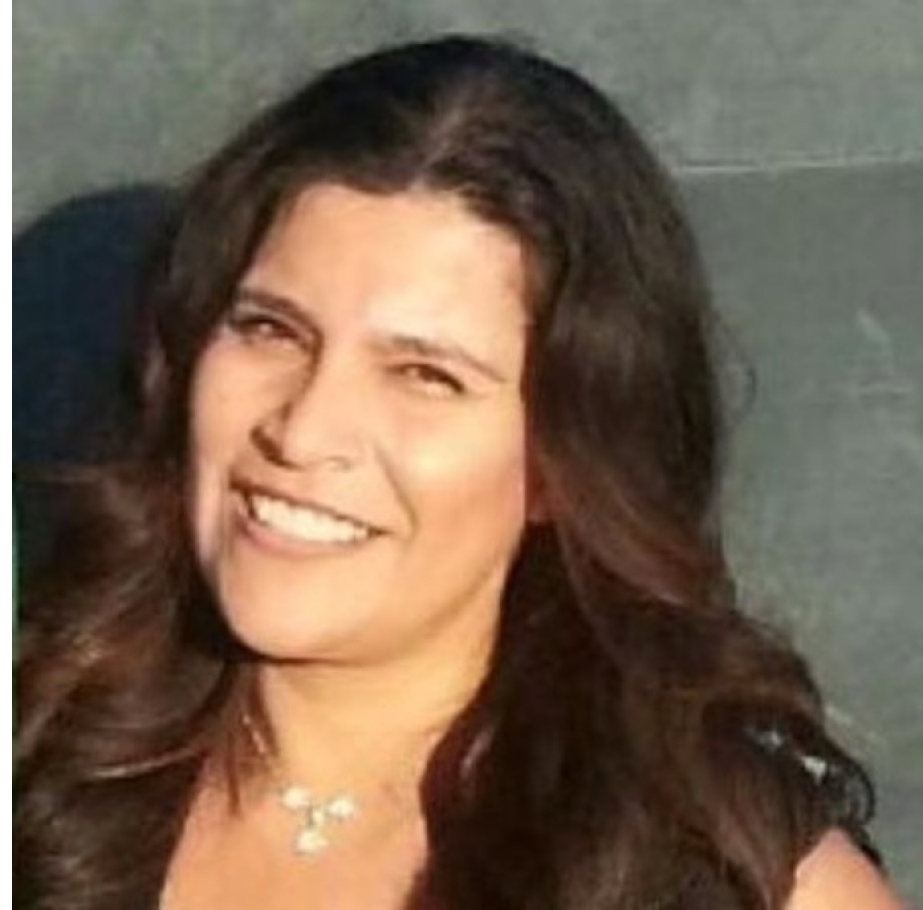




TEAM
Ana Davalos
Diana Chacon
Paula Urteaga
Frances Gliane
Evgeniya Grigoreva

Slide 3
Day 1
Topic - California Power Generation & Power sources
Data Set: https://gis.data.ca.gov/datasets/CAEnergy::california-power-plants?geometry=-147.509%2C31.065%2C-82.163%2C43.271
Inspiration
Ideal Visuals
Proposal

Slide 4
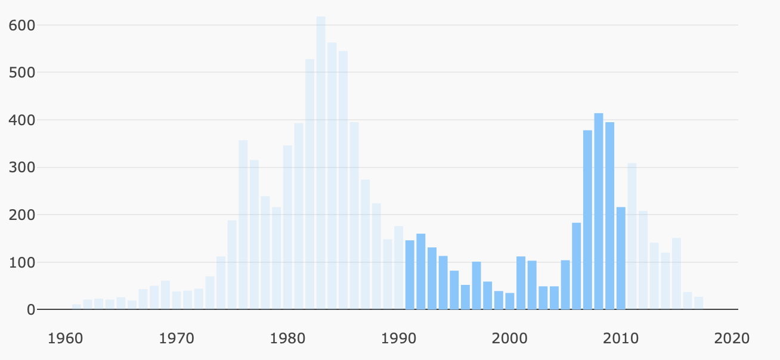
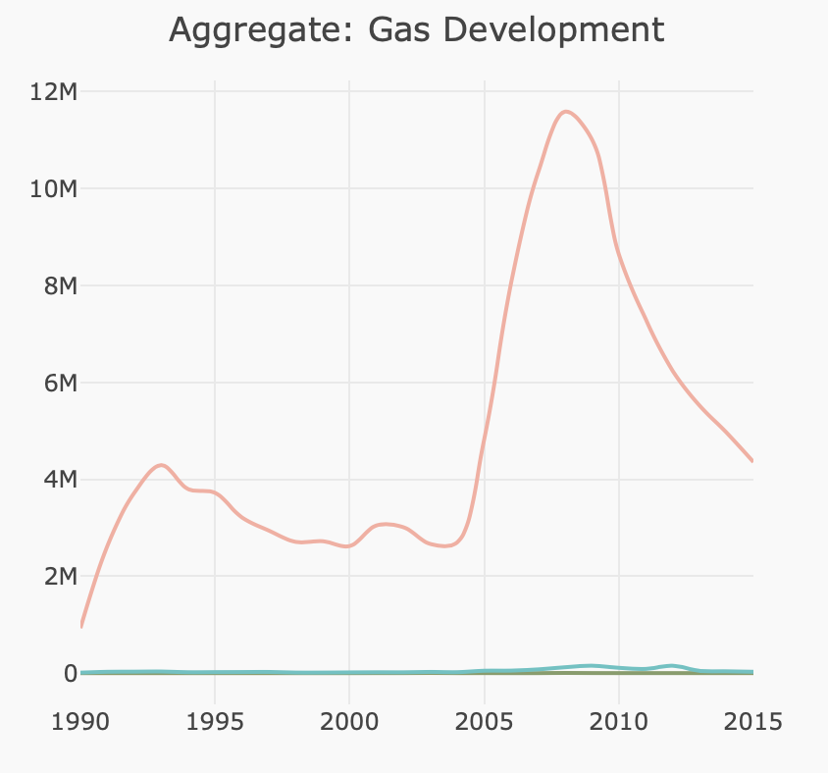
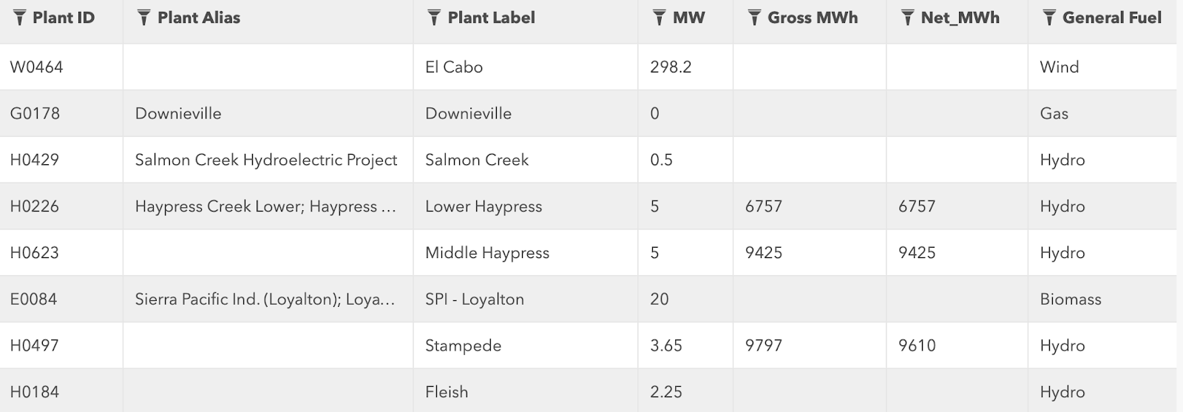
Day 1. inspiration

Slide 5
Day 1. inspiration

Slide 6
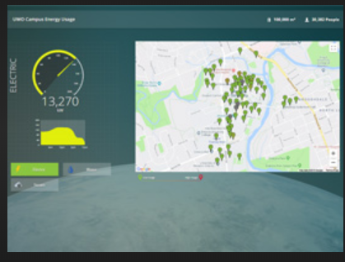
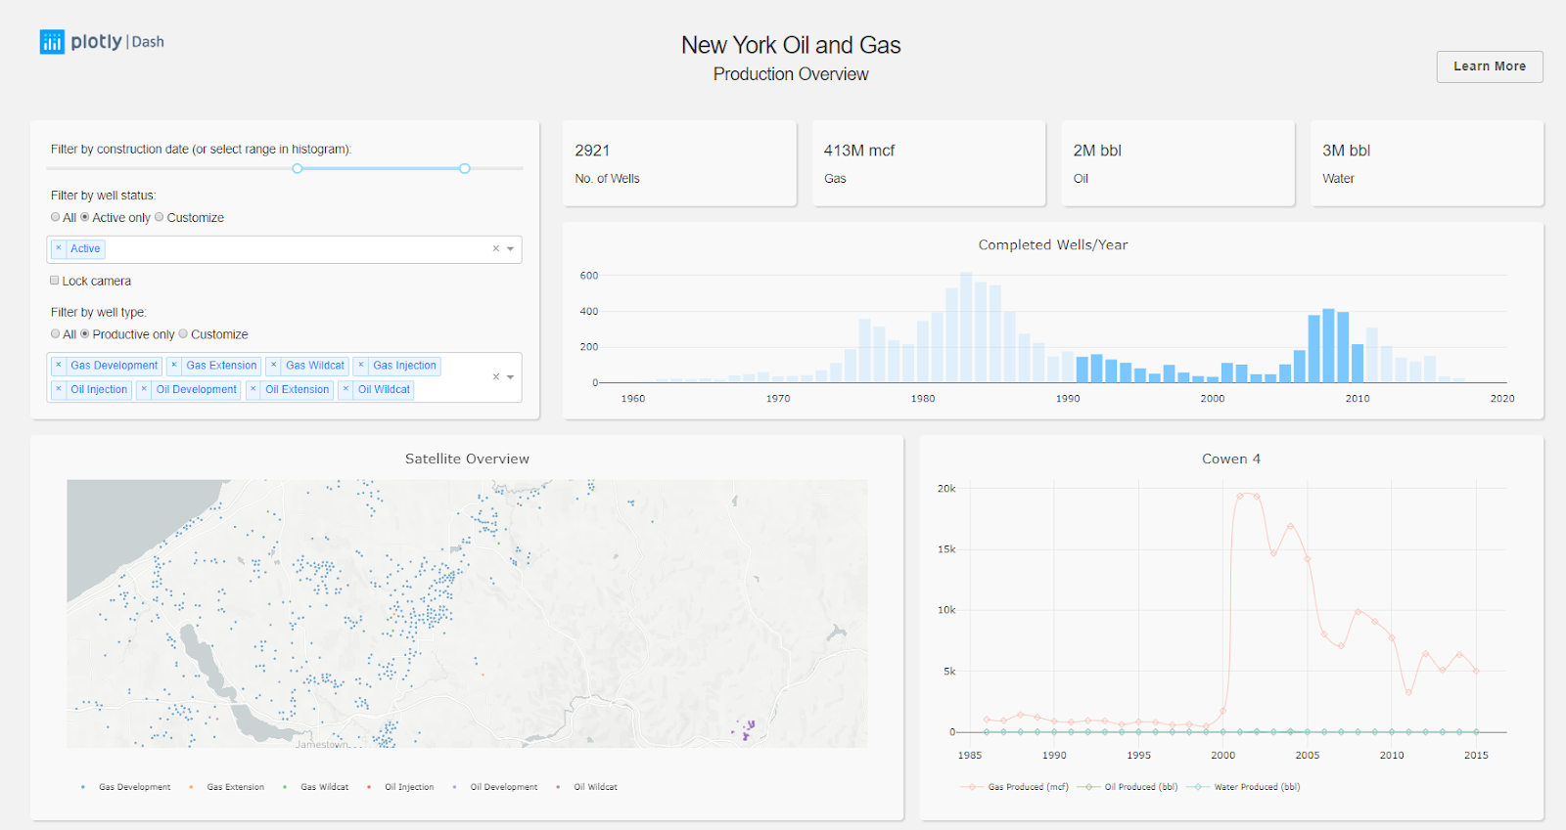
Day 1. inspiration

Slide 7
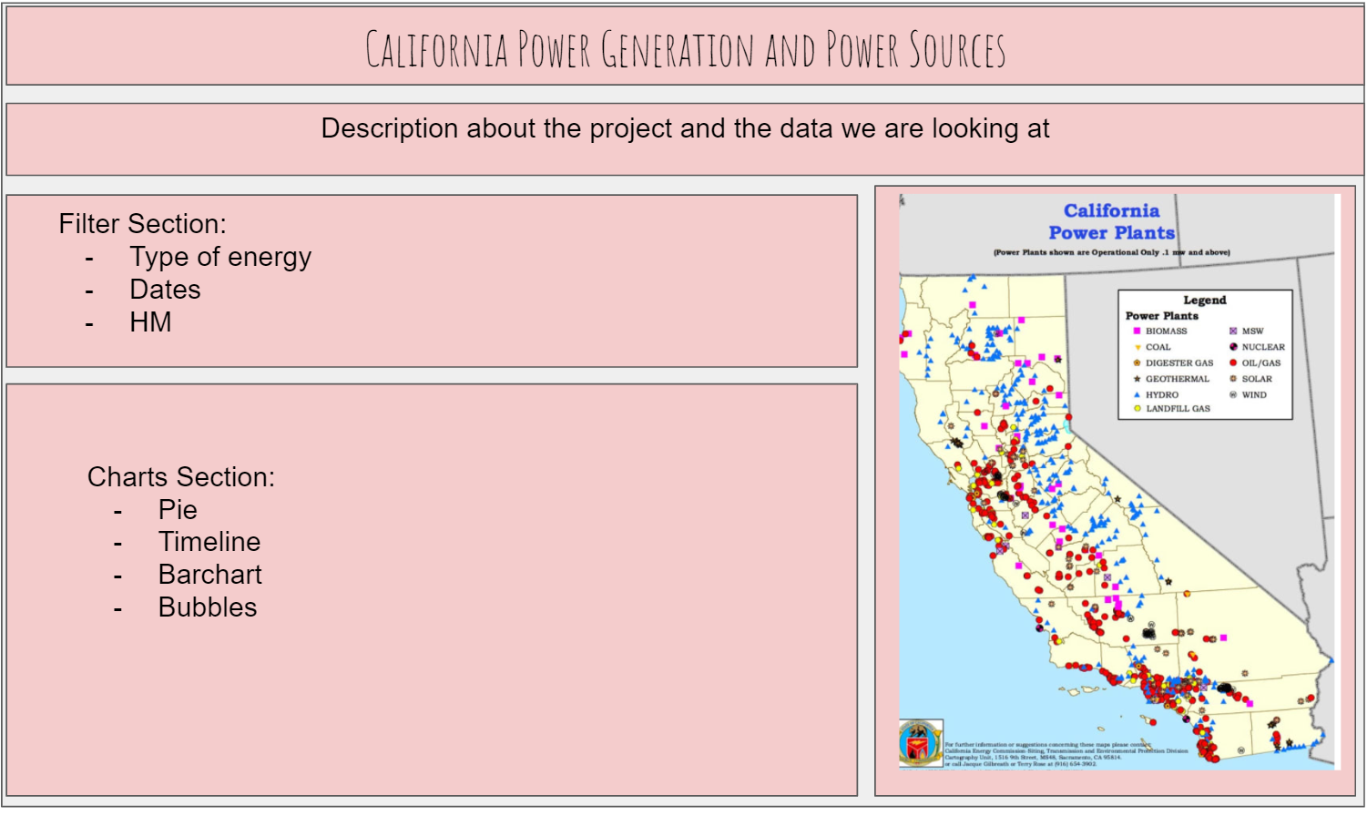
Day 1. UI PROTOTYPE

Slide 8
Day 2
Brief articulation
Metadata
Sketch of the final design
Link to the Primary GitHub: https://github.com/dcchacon/WhoRunTheWorld_Energy

Slide 9
DAY 2. BRIEF ARTICULATION
California has large energy resources, being among the top producers of oil, hydroelectricity, solar, biomass, and geothermal energy in the US. Our dashboard displays installations, consumptions, and distribution.

Slide 10
DAY 2. BRIEF ARTICULATION
California has large energy resources, being among the top producers of oil, hydroelectricity, solar, biomass, and geothermal energy in the US. Our dashboard displays installations, consumptions, and distribution.

Slide 11
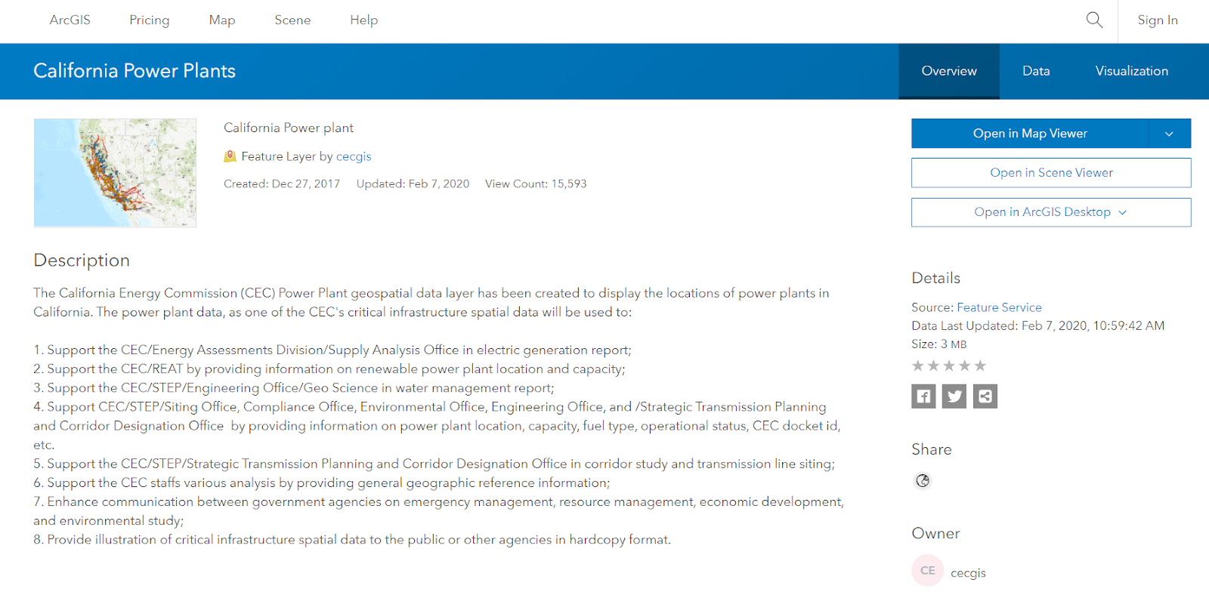
Day 2. METADATA

Slide 12
Day 3
PROJECT ROAD MAP DESIGN
Scrape the date when our dataset was updated
Flask -> GeoJSON (as a file) -> S3
GeoJSON file / READ / ROUTE

Slide 13

JavaScript
Call API
Flask: Use SQLite, to create an API
ML
DATA

Slide 14
DAY 4-5-6
Project DESIGN
Javascript coding
PYTHON + FLASK CODING

Slide 15


PROJECT DESIGN
LEAFLET. Energy Types
PLOTLY. Bar chart
PLOTLY + HIGH CHARTS. Timeline chart + Pie Chart
PLOTLY. Bubble chart
PYTHON + FLASK. HTML table

Slide 16
LEAFLET. Energy Types

Slide 17
PLOTLY. Bar chart

Slide 18
PLOTLY. Timeline chart

Slide 19
PLOTLY + HIGH CHARTS. Pie Chart

Slide 20
PLOTLY. BUBBLE Chart

Slide 21
PYTHON + FLASK. HTML table

Slide 22



GITHUB TEAMWORK
GITHUB PROJECT 1
GITHUB PROJECT 2
WHEN WE WORK TOGETHER, EVERYBODY WINS

Slide 23



Process
GeoJSON
HTML PAGE
ENERGY PROJECT
JAVASCRIPT LIBRARIES,
PYTHON
FLASK

Slide 24

Questions?
Check our GITHUB repository for results:
https://github.com/dcchacon/WhoRunTheWorld_Energy
https://github.com/paulaurteaga/Project3
GITHUB PROJECT 1
GITHUB PROJECT 2

